Slide 1
Agenda
Covered Facilities
Patient Sleeping Rooms
Parking & Passenger Loading Zones
Accessible Routes
Employee Work Areas
Service Counters
Public and Common Use Areas
Medical Diagnostic Equipment

Slide 2
Medical Care and Long-Term Care Facilities
§223 & §805

Slide 3


Covered Facilities
Hospitals, Rehabilitation Facilities, Psychiatric Facilities and Detoxification Facilities
Long-term Care Facilities

Slide 4
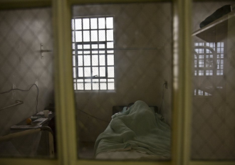
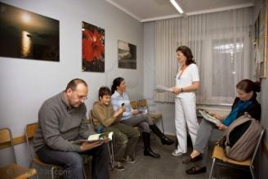
Covered Facilities cont’d
Medical units in detention and correctional facilities
Professional Offices of Healthcare Providers

Slide 5
Patient Sleeping Rooms

Slide 6
Patient Sleeping Rooms
§223.2 - Hospitals, Rehabilitation Facilities, Psychiatric Facilities and Detoxification Facilities:
Conditions Affecting Mobility
  Specializing 100%
  Not specializing 10%
§223.3 Long-term care: 50%
6

Slide 7
Patient Sleeping Room Dispersion
    Medical Care Facilities Covered by 2010 ADA Standards:
    Must disperse accessible patient bedrooms in a manner that is “proportionate” by type of medical specialty
    Regulatory sections 35.151(h) and 36.406(g) incorporated by DOJ
7

Slide 8
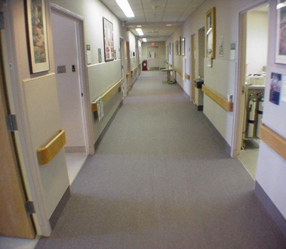
Patient Sleeping Rooms
Alterations and Additions
Based on the number
altered or added until
overall number reached
  maintains dispersion
Hospital corridor
8

Slide 9

Long Term Care Facilities
§223 Medical Care and Long-Term Care Facilities
§223.3 Long-Term Care Facilities
“In licensed long-term care facilities, at least 50 percent, but no fewer than one, of each type of resident sleeping room shall provide mobility features complying with 805.”

Slide 10
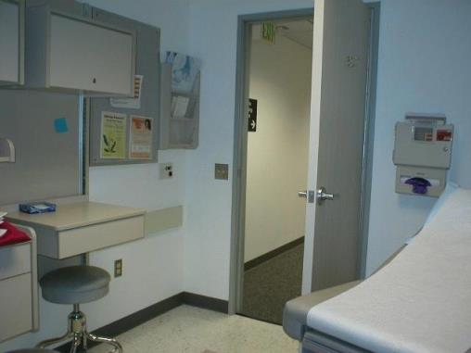
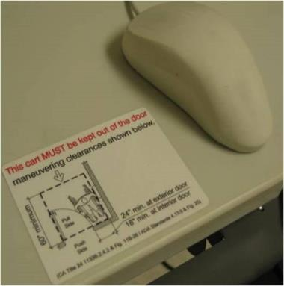
Doors – Latch Side Clearance
Drawing showing a trash can blocking the 18 inch maneuvering space to the side of a door and a person in a wheelchair being blocked from reaching the latch.
ADAAG figure depicting the space requirements for a swinging door with a front approach on the pull side.
§404.2.4 Maneuvering Clearances
must not be obstructed
ADA regulations to maintain accessible features

Slide 11
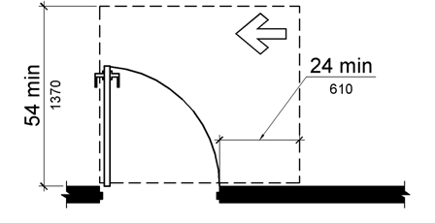
Doors – §404.2.4 Exception
Entry doors to hospital patient rooms not required to provide the clearance beyond the latch side of the door.
plan figure from Standards showing maneuvering clearances in front of and to the latch side of the door
11

Slide 12
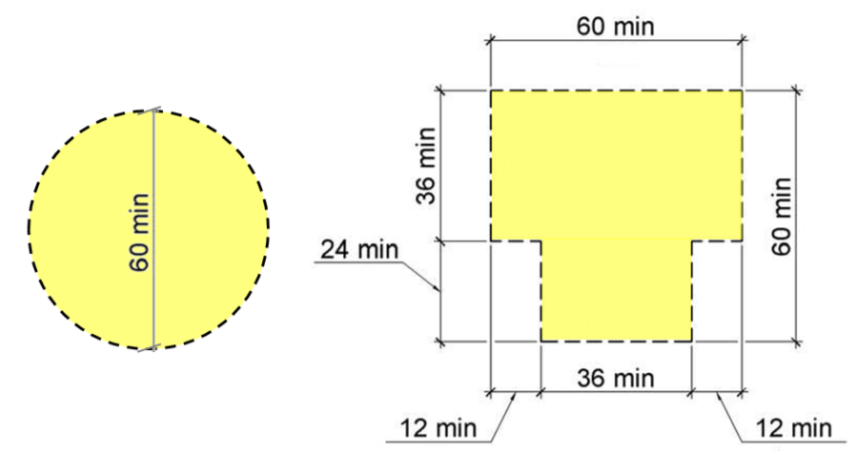
Turning Space (§805.2)
60” Diameter Circle
T-Shaped Space
Turning space complying with §304 must be provided within the room

Slide 13
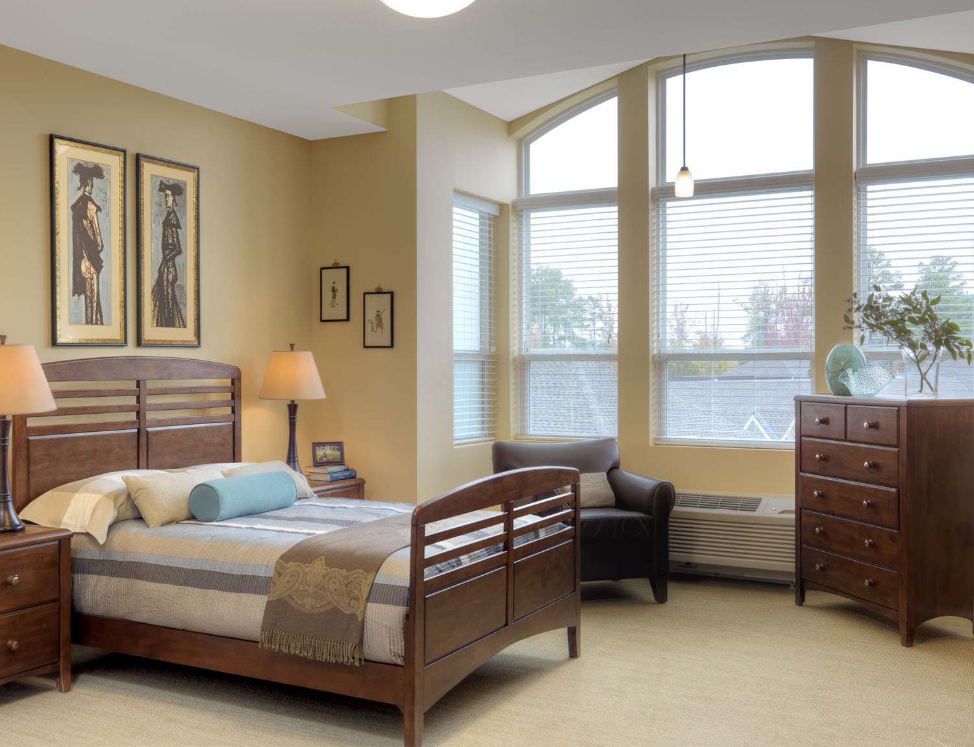
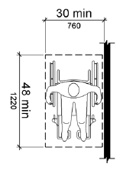
Clear or Ground Floor Space (§805.3)
must provide a clear floor space complying with section §305 on both sides of the bed

Slide 14
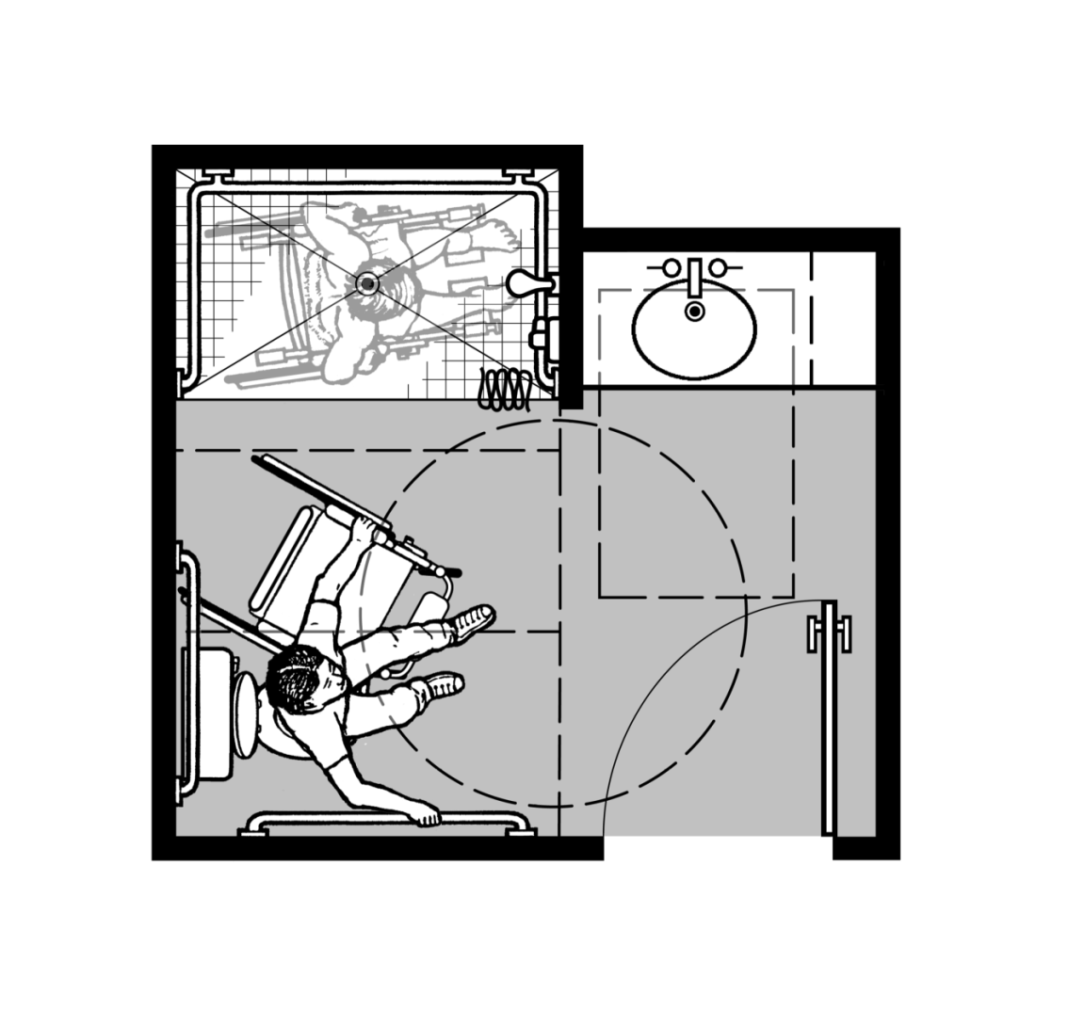
Patient Sleeping Rooms
Toilet and Bathing
Those serving patient rooms required to be accessible
  Exception for toilets
  in critical care or
  intensive care
  patient rooms
14

Slide 15
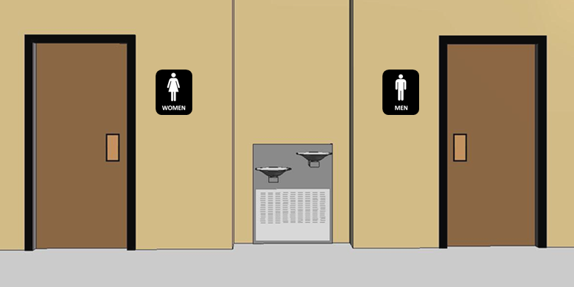
Toilet & Bathing Facilities (§213)
In new construction, all toilet and bathing facilities must be accessible, except:
portable units (5% min)
clustered single user toilet rooms (50% min)
15

Slide 16
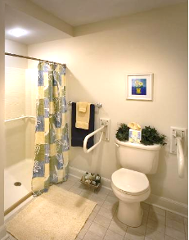
ANSI A117 Working Groups
Working Group on Assisted Toileting and Bathing
Establishing technical requirements for toileting and bathing facilities designed for assisted use.
Based on study by Rothchild’s Foundation
Assisted living, nursing homes and rehabilitation Facilities (resident bathrooms)
Alternative to units required to provide independent access
Specifications for toilets and roll-in showers
IBC 2021 to include scoping
Notes:
ASTM F 1487-01 establishes a nationally recognized safety standard for public playground equipment to address injuries identified by the U.S. Consumer Product Safety Commission.
It defines the use zone, which is the ground area beneath and immediately adjacent to a play structure or play equipment designed for unrestricted circulation around the equipment and on whose surface it is predicted that a user would land when falling from or exiting a play structure or equipment.
The play areas requirements reference the ASTM F 1487 standard when defining accessible routes that overlap use zones requiring fall attenuating surfaces. If the use zone of a playground is not entirely surfaced with an accessible material, at least one accessible route within the use zone must be provided from the perimeter to all accessible play structures or components within the playground.

Slide 17
Communication Features

Slide 18
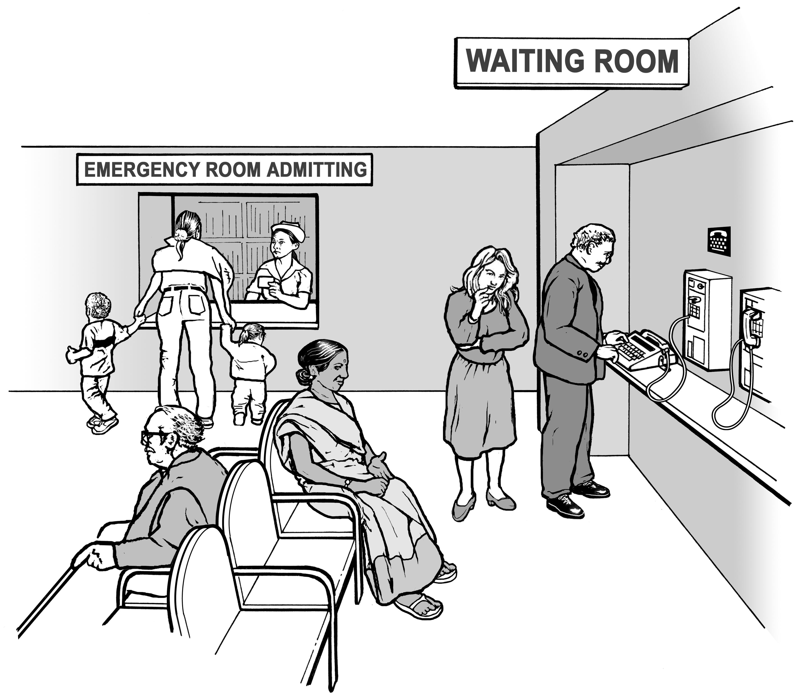
TTY’s
§217.4.6 - Public pay telephones
  Where provided at hospital emergency room, recovery room, or waiting room – at least one TTY
tty on public telephone
18

Slide 19

Fire Alarms Systems
§702.1 General - NFPA 72
NFPA 72 National Fire Alarm Code (1999 or 2002) – referenced standard
National Fire Protection Association (www.nfpa.org)

Slide 20

Fire Alarms Systems
§702.1 - Medical Facilities
EXCEPTION: Fire alarm systems in medical care facilities permitted to be provided in accordance with industry practice
20

Slide 21
Parking and Passenger Loading Zones

Slide 22
New Construction
Access Required
Parking is not required to be provided
Where parking is provided, it must include accessible parking spaces
Excludes commercial vehicle storage, law enforcement vehicles, or vehicle impound parking

Slide 23
Accessible Parking Scoping
Where visitor, patron, or employee parking is provided
Calculated on a facility by facility basis
A facility can be a single space, a parking lot, a parking floor within a building, or a stand-alone parking structure

Slide 24
Accessible Parking Scoping
208.2 Parking Spaces
Total Number of Parking Spaces Provided in Parking Facility | Minimum Number of Required Accessible Parking Spaces
1 to 25 | 1
26 to 50 | 2
51 to 75 | 3
76 to 100 | 4
101 to 150 | 5
151 to 200 | 6
201 to 300 | 7
301 to 400 | 8
401 to 500 | 9
501 to 1000 | 2 percent of total
1001 and over | 20, plus 1 for each 100, or fraction thereof, over 1000

Slide 25
Accessible Parking
§208.2.1 Hospital Outpatient Facilities: 10 % of spaces
§208.2.2 Rehabilitation and Outpatient Physical Therapy Facilities: 20 %
25

Slide 26
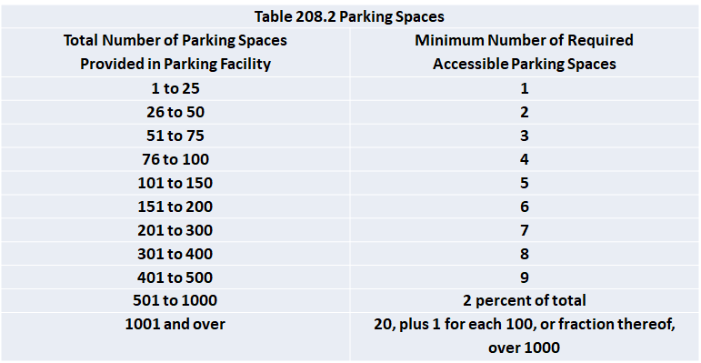
Accessible Parking Scoping
Doctor’s Offices: use table
Medical Equipment Retail Facilities: use table
26

Slide 27
Accessible Parking
Hospital Aerial View
§208.3 Location – Exception 2
27

Slide 28
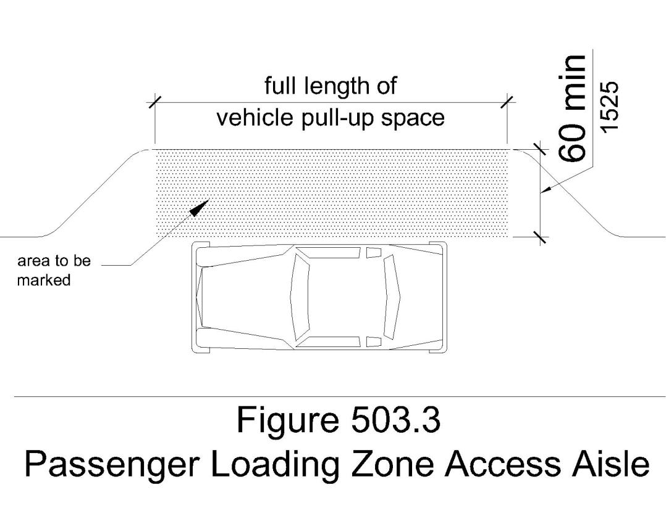
Loading Zone Access Aisle

Slide 29
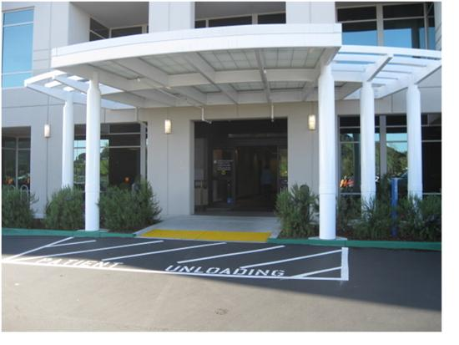
Passenger Loading at Entrance (§209.3)
Required where period of stay exceeds 24 hours
Canopy not required as was in 1991 ADA Standard

Slide 30
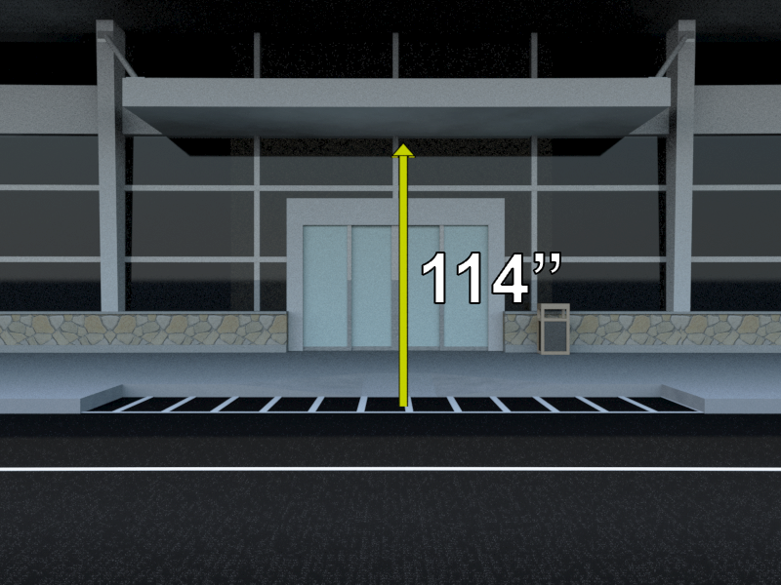
Loading Zone Vertical Clearance

Slide 31


Parking Space Signs
International Symbol of Access required to designate and reserve accessible spaces
60 inches minimum to bottom of sign
“Van Accessible” added for van spaces
Exception: sign not required where 4 or fewer spaces are provided

Slide 32
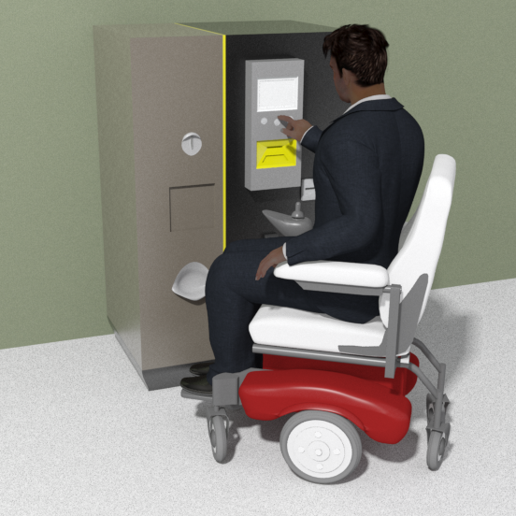
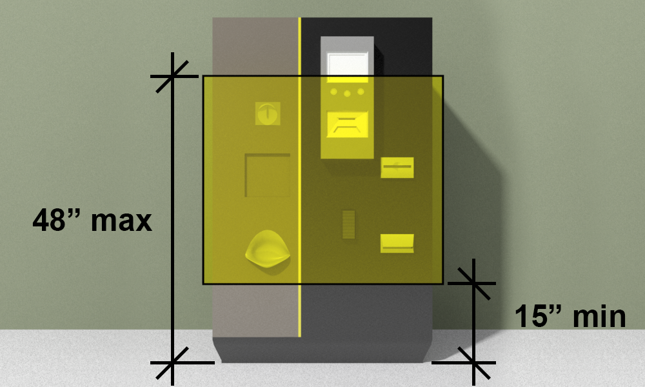
Parking Meters and Pay Stations
Forward or Side Approach
Operable Parts

Slide 33
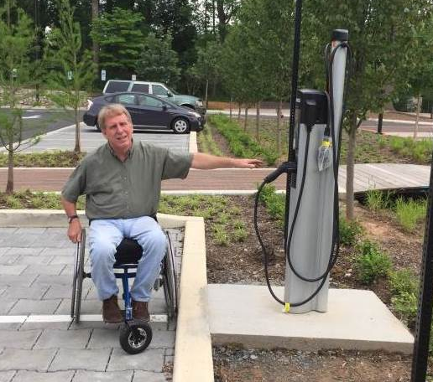
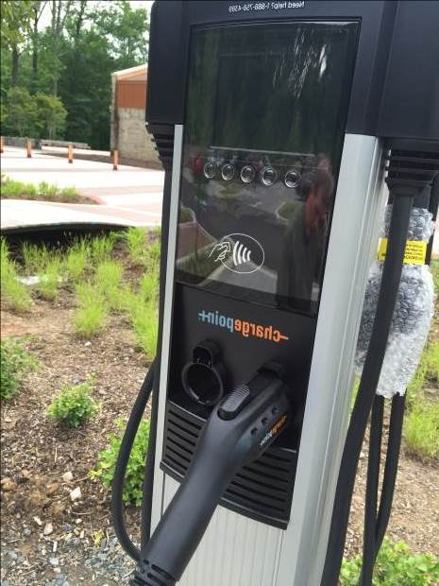

Electric Vehicle Charging Stations
The Standards do not include specific provisions for electric vehicle (EV) charging stations.
Advisable to address access to EV charging stations so that they are usable by people with disabilities.
If provided, accessible spaces at EV charging stations cannot count toward the minimum number of accessible car and van parking spaces required in a parking facility.

Slide 34
Accessible Routes

Slide 35
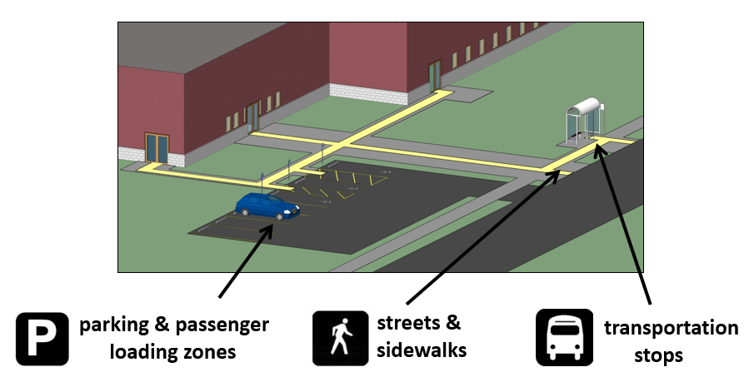
Accessible Routes (§206)
At least one accessible route to building entrances from site arrival points provided
Site arrival points: parking, passenger loading zone, public sidewalk, and transit stop connected to accessible entrance by an accessible route.

Slide 36
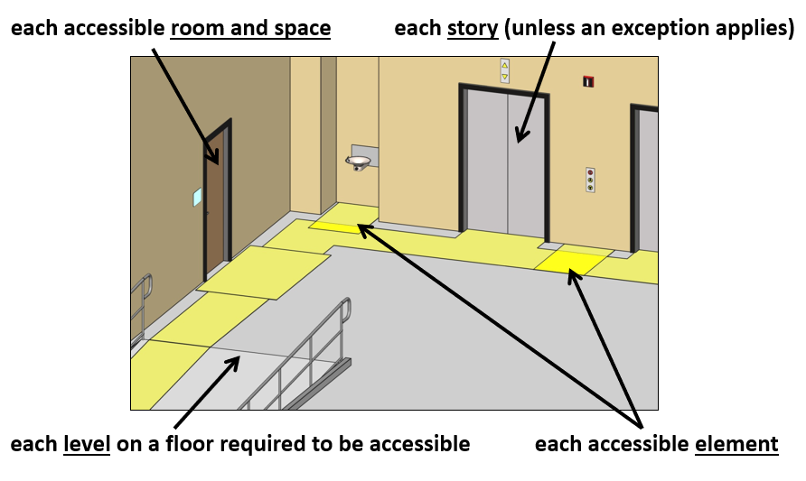
Accessible Routes
At least one AR must connect to:
Graphic of Site arrival points: parking, passenger loading zone, public sidewalk, and transit stop connected to accessible entrance by an accessible route.

Slide 37
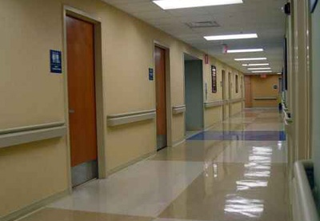
Handrails along Routes (403.6)
Handrails - where provided along walking surfaces other than ramps or stairs also must comply (excluding elevator cars)
37

Slide 38

Route Location (§206.3)
Must coincide or be in same area as general circulation paths
Photo of a glass enclosed sky bridges between buildings
If circulation path is interior, AR must be interior

Slide 39
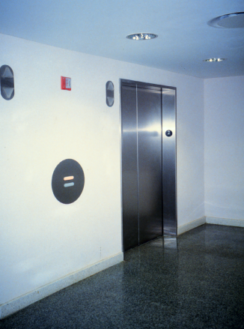
Vertical Access
Required for Professional Offices of a Healthcare Provider
  Where a State-regulated professional provides physical or mental health services to the public
Title II entities and Federal facilities
elevator

Slide 40
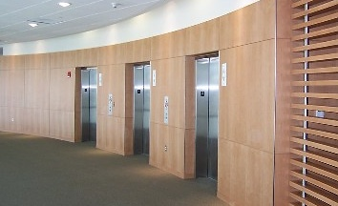
Multi-Story Facilities (§206.2.3)
At least one accessible route must connect each story & mezzanine (unless an exception applies)
Photo of elevator bank (3 cars)

Slide 41
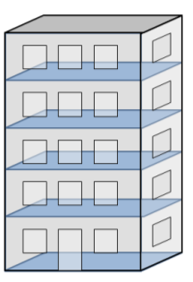
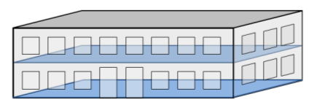
Exceptions (§206.2.3)
Accessible Route between floors (“elevator exception”)
Private sector facilities only:
less than 3 stories OR less than 3,000 sf/flr)

Slide 42
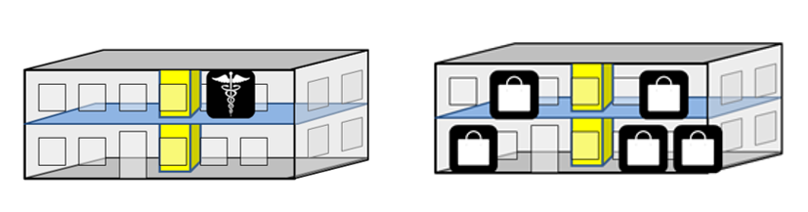
Exceptions
Accessible route required to upper story:
containing a sales/rental establishment (if facility contains at least 5 total)
containing a health care facility
Graphic image of building with health care facility on second floor and a second building with 5 retail establishments, some of which are located on second level

Slide 43
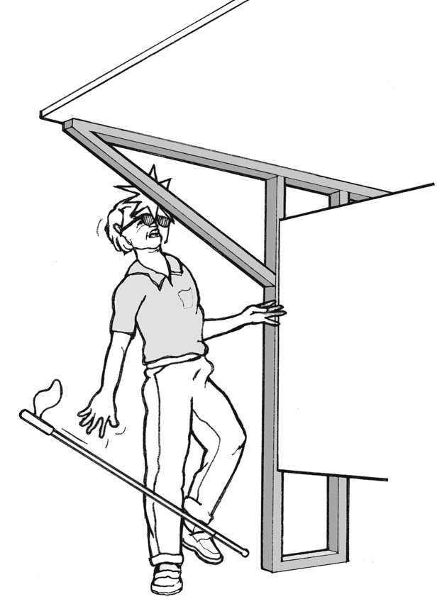
Protruding Objects
Applies to all circulation paths (F204)

Slide 44
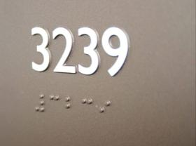
Signs (§216)
Tactile/ visual – labels for permanent rooms & spaces, exit doors
Visual only – directional or informational signs
Exempt: temporary signs, building menus, directories, addresses, company names and logos
44

Slide 45
Tactile Signs
Scoping (interior & exterior):
Restroom labels (at entry)
Room numbers/ names (not likely to change)
Floor levels
Exit access/discharge
Areas of Rescue Assistance
45

Slide 46
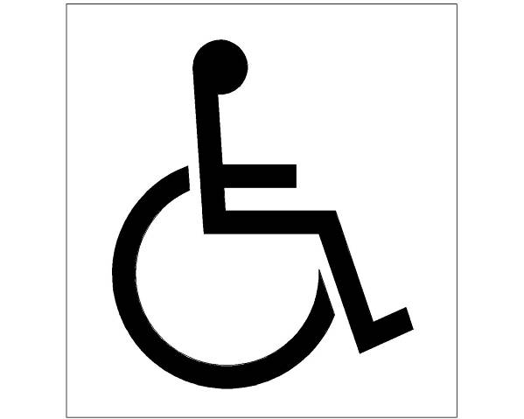
Signs (216)
Required Signs
Means of egress
Parking
Entrances
Elevators
Toilet and bathing rooms
TTYs
Assistive listening systems
Check-out aisles
Other Info Pictograms
Directional Signs
46

Slide 47
Employee Work Areas

Slide 48
Employee Work Area (§106.5)
“All or any portion of a space used only by employees and used only for work. Corridors, toilet rooms, kitchenettes and break rooms are not employee work areas.”
Americans with Disabilities Act (ADA)
Limited access required
“approach, enter, and exit”.
Architectural Barriers Act (ABA)
Must be accessible.

Slide 49
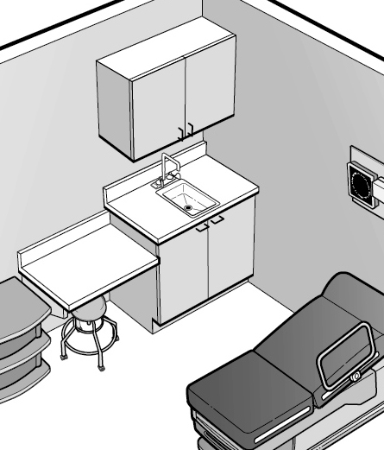
Employee Work Areas
Perspective drawing of a exam room sink for medical staff use only, sink has a bas cabinet beneath lavatory and is not accessible for a forward approach.
Requirements for hand wash sinks in exam rooms
49

Slide 50
Service Counters

Slide 51
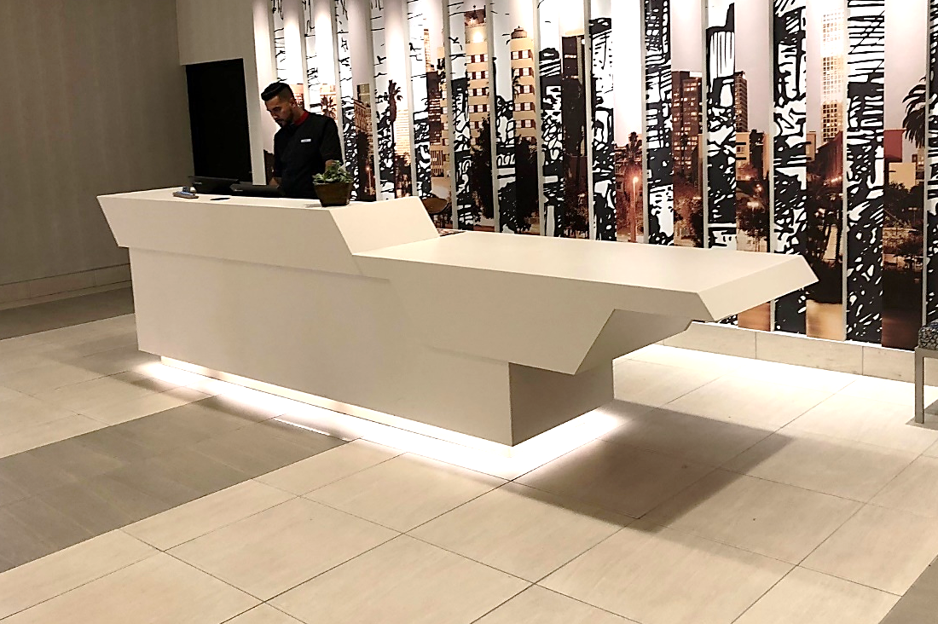
Minimum Number & Dispersion (§227.3)
At least 1 of each type of counter
Each type of function at a counter
Dispersion where counters dispersed
Screen shot of Access Board web site home page. Red row near top says The Board, Guidelines & Standards, Training, Enforcement, Research.

Slide 52
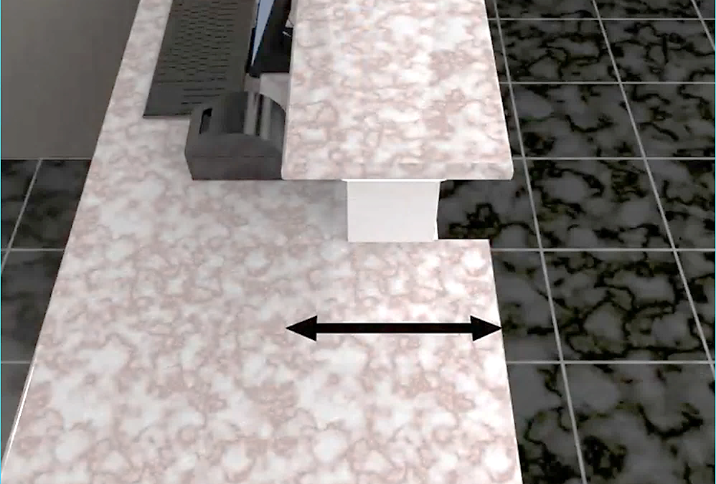
Check-In Counter
Screen shot of Access Board web site home page. Red row near top says The Board, Guidelines & Standards, Training, Enforcement, Research.
Accessible portion must be as deep as the counter depth for customer use.

Slide 53
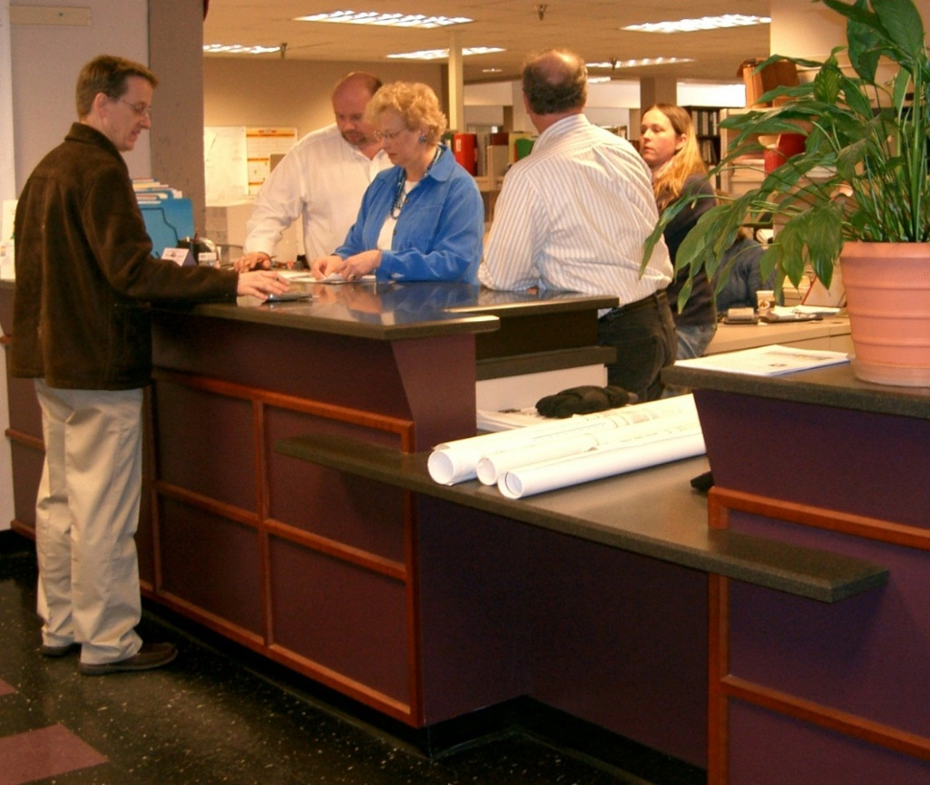
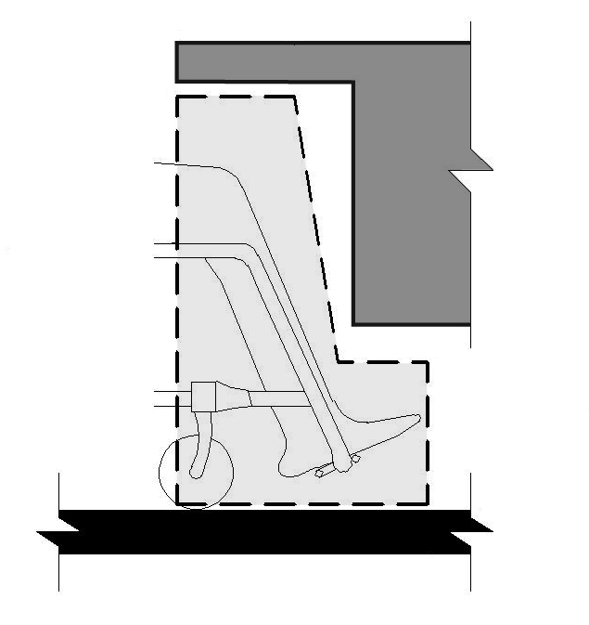
Service Counters
Photo of a service counter with a forward approach.
Drawing of the required knee and toe space under an element.
Side or Forward Approach Required

Slide 54
Public and Common Use Areas

Slide 55
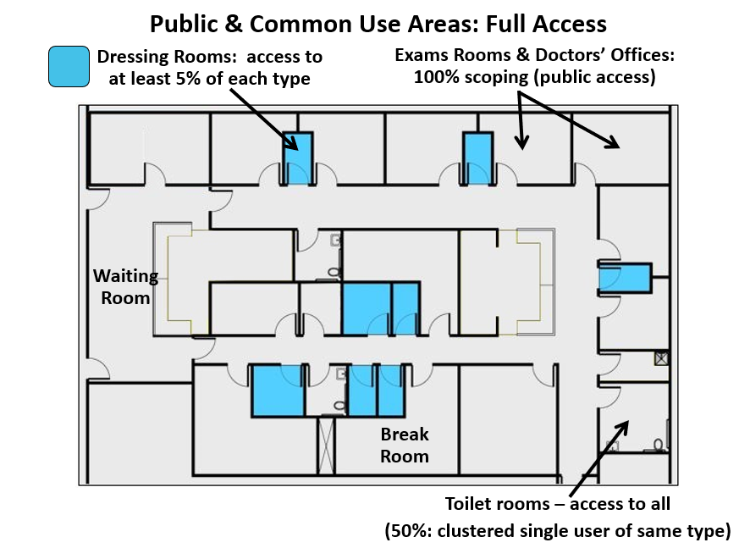
Example: Medical Care Suite
Medical suite plan with multiple dressing rooms highlighted (at least 5% of each type required to be accessible); also shown are other public or common use areas, including exam rooms, doctors' offices, waiting room, break room, and toilet rooms.
Labels:
Public & Common Use Areas: Full Access
Dressing Rooms: access to at least 5% of each type
Common Use (Non-Work) Areas: Full access
Exams Rooms: 100% scoping (public access)
Clustered toilet rooms (50% min. scoping)

Slide 56
Common Use Spaces - Living
56

Slide 57


Dining & Work Surfaces (§226)
Access to at least 5% of surfaces
Applies to both standing and seating spaces Dispersion within space/ facility required
Screen shot of Access Board web site home page. Red row near top says The Board, Guidelines & Standards, Training, Enforcement, Research.

Slide 58
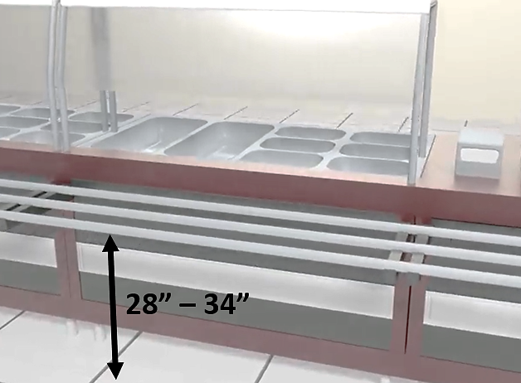
Tray Slides
Tray slides are not required but must comply where provided

Slide 59
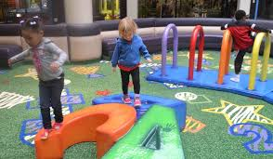
Recreation/Rehabilitation Facilities
Play areas
Exercise or workout rooms
Exercise equipment
Locker rooms
Swimming pools
Spas or Saunas
Screen shot of Access Board web site home page. Red row near top says The Board, Guidelines & Standards, Training, Enforcement, Research.

Slide 60
Children’s Toilets
Advisory information provides guidance according to age group
 | Ages 3 & 4 | Ages 5 - 8 | Ages 9 - 12
WC Centerline | 12 in | 12 - 15 in | 15 - 18 in
Toilet Seat Height | 11 - 12 in | 12 - 15 in | 15 - 17 in
Grab Bar Height | 18 - 20 in | 20 - 25 in | 25 - 27 in
Dispenser Height | 14 in | 14 - 17 in | 17 - 19 in
60

Slide 61
Medical Diagnostic Equipment (MDE)

Slide 62
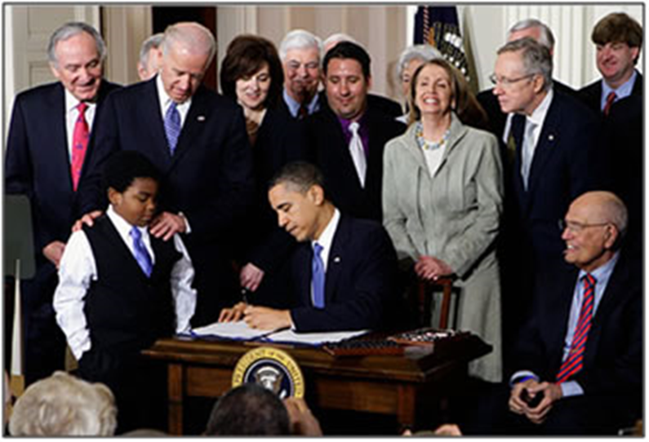
Rehabilitation Act §510
Mandates the Access Board to issue minimum technical criteria for accessible medical diagnostic equipment in consultation with FDA
Affordable Care Act amends the Rehabilitation Act to address access to MDE
(March 23, 2010)

Slide 63
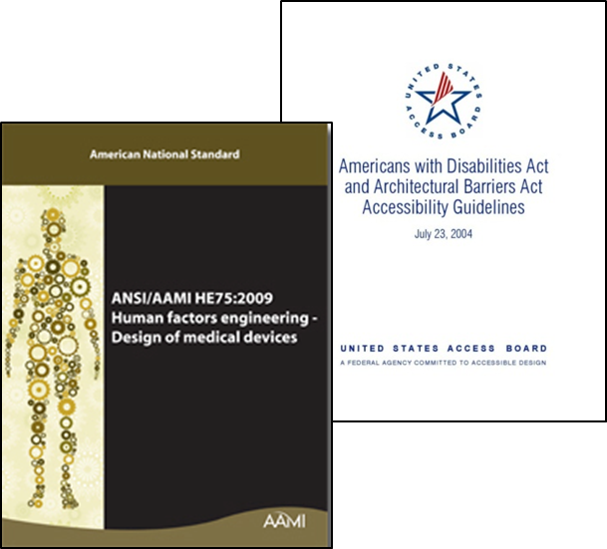
Rehabilitation Act §510
Specifically addresses equipment in:
  Physicians offices, clinics, emergency rooms, hospitals, other medical settings. Includes optometrists and dentists
Scoping to be determined in appropriate regulatory or administrative context
Final Standards are voluntary until adopted by an enforcing Agency e.g., DOJ for the Americans with Disabilities Act
Can be voluntarily adopted through policy

Slide 64
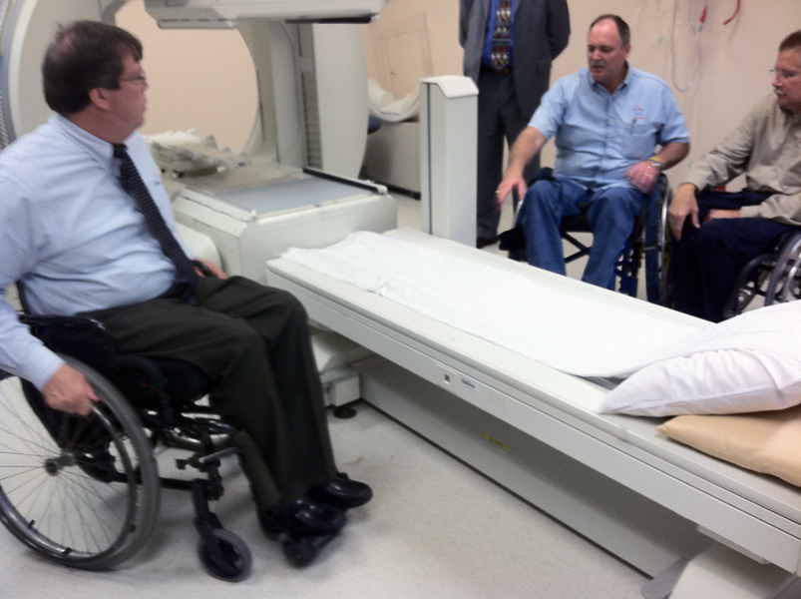
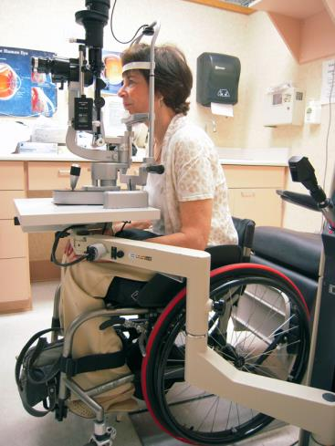
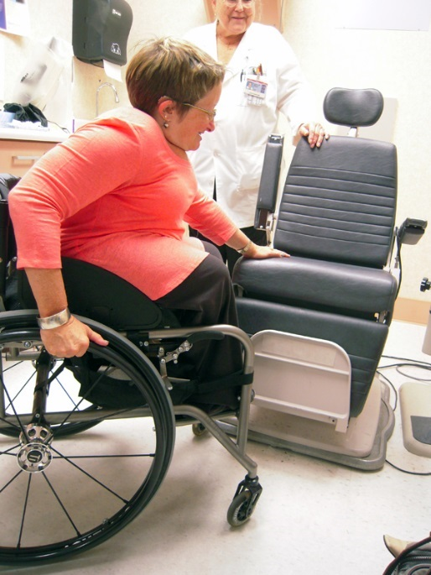
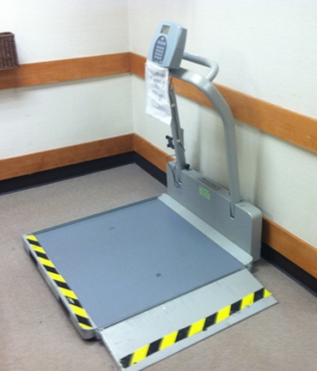
MDE - Examples
Examination tables and chairs
Weight scales, x-ray machines
Radiological
and mammography equipment

Slide 65
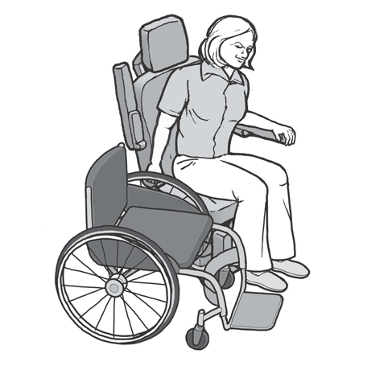
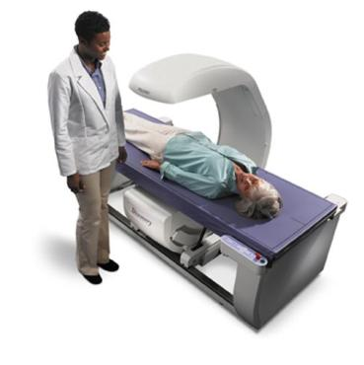
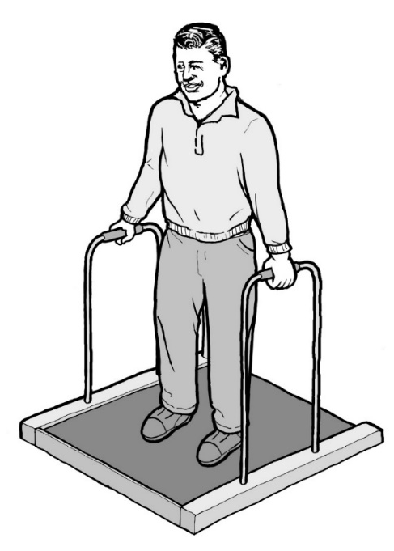
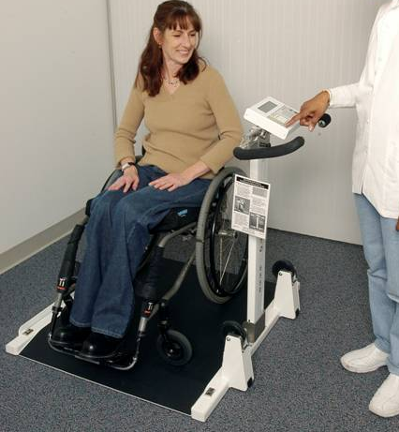
Patient Positions the Equipment Supports
in a supine, prone, or side-lying position
in a seated position
seated in a wheelchair
in a standing position

Slide 66


DOJ Guidance is Available
ww.ada.gov
800-514-0301
sketch of examination room with women on table and doctor leaning over her.
example page from the Access to Medical Care for Individuals with Mobility Disabilities document
66

Slide 67

67
Standards for Accessible Medical Diagnostic Equipment
www.access-board.gov/guidelines-and-standards/health-care/about-this-rulemaking/final-standards

Slide 68

Technical Guides to the Standards
Available on the Access Board website

Slide 69
Questions ?
71

Slide 70
U.S. Access Board
(800) 872-2253 (voice)
(800) 993-2822 (TTY)
E-mail: ta@access-board.gov
www.access-board.gov
72

